Slide 1
113年自行研究計畫案 用於優化路檢聯稽績效之預測模型研究 (以新竹所為例)
吳季娟、張耀輝、廖雲枝、楊騏銘

Slide 2
研究大綱
研究說明與現況
研究流程
資料特徵概述
資料分布(違規與通知臨檢)
迴歸模型建立與分析

Slide 3
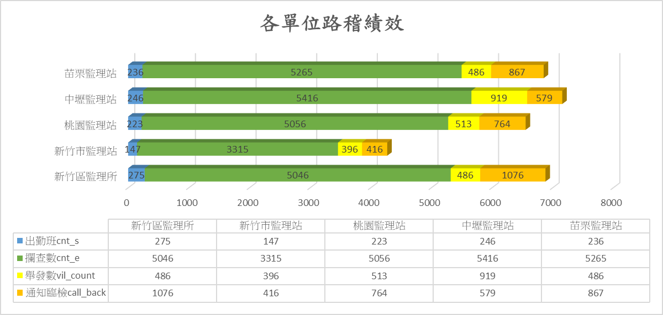
研究說明與現況
所站 | 出勤班次 | 攔查數 | 舉發數 | 通知臨檢數 | 所站績效(%) | 名次
臺北市區監理所 | 222 | 4803 | 423 | 938 | 28.34 | 2
高雄市區監理所 | 192 | 4230 | 797 | 381 | 27.85 | 3
臺北區監理所 | 1054 | 23423 | 3251 | 3725 | 29.78 | 1
新竹區監理所 | 1127 | 24098 | 2800 | 3702 | 27.32 | 5
臺中區監理所 | 1308 | 28854 | 7056 | 878 | 27.50 | 4
嘉義區監理所 | 1000 | 21957 | 3794 | 1425 | 25.37 | 7
高雄區監理所 | 771 | 17261 | 4298 | 329 | 26.81 | 6
提案理由
路檢聯稽為監理單位與警方共同打擊交通違規之合作案。希望透過運用過去路檢聯稽數據，建立違規與通知臨檢數量預測模型，用以動態安排路稽班次，精準打擊交通違規。
目標
建立違規與通知臨檢數預測模型，並據此安排適當的人員數量與稽核班次，提高路檢聯稽排班準確程度與績效，精準打擊交通違規，替廣大用路人交通安全把關。
※ 績效 = (舉發數+通知臨檢數) / 攔查數 (%)
轄管監理站

Slide 4
研究流程
資料蒐集
公路局M3系統資料庫(路檢聯稽與違規)
資料使用限制：2022年10月至2023年10月、新竹所管轄
資料前處理
資料清洗
特徵選擇
模型建立
模型選擇
模型訓練
模型評估
實際應用
Loss
參考預測模型，安排路檢聯稽班次
績效評估
R-squared score (R2 score)

Slide 5
資料特徵概述
Column | Description | Column | Description
exam_station_id | 監理機關代碼 | exam_item_no | 檢驗違規項目代碼
exam_location_id | 路檢聯稽地點代碼 | 檢驗違規項目名 | 檢驗違規項目名
exam_location_description | 路檢聯稽地點 | exam_sub_class_no | 檢驗違規子項目代碼
exam_schedule_begin_time | 聯稽開始時間 | 檢驗違規子項目名 | 檢驗違規子項目名
exam_schedule_end_time | 聯稽結束時間 | exam_item_id | 通知臨檢項目代號
rule_no | 違規條款代碼(若有違規的話) | 通知臨檢項目代號描述 | 通知臨檢項目代號描述
vil_source_rule | 違規條款來源(道路交統管理處罰條例or公路法) | 通檢子項目序號 | 通知臨檢子項目序號
plate_no_main | 路檢聯稽車牌號碼 | 通知臨檢子項目名稱 | 通知臨檢子項目名稱
exam_staff_id | 路檢聯稽監理人員 | violation | 路檢聯稽違規入案序號
car_type | 聯稽車種代碼 | need_call_back | 路檢聯稽車輛是否需招回臨檢(通知臨檢)
聯稽車種 | 聯稽車種 | df_vil / df_callback | 違規數 / 通知臨檢數
資料說明
資料時間區間：2022-10-01 ~ 2023-10-31
監理單位：新竹區監理所及轄管監理站(新竹市監理站、桃園監理站、中壢監理站、苗栗監理站)
路檢聯稽稽核班次：營業大客車、砂石車危險物品、機車、大貨車及聯結車、其他
資料筆數：24720
資料前處理
去掉多餘欄位
時間欄位處理(月、日、時、分獨立欄位；去掉年)
need_call_back欄位空值填入
violation欄位轉換(0 無違規 / 1 有違規)
「類別欄位」做one-hot encoding
資料分群，並計算違規/通知臨檢數(衍生欄位；作為machine learning的label)
原始資料隨機分為訓練集與驗證集(training : validation = 80 : 20)
綠字： 多餘欄位 棕字：時間欄位處理 紅字：label欄位(衍生欄位)

Slide 6
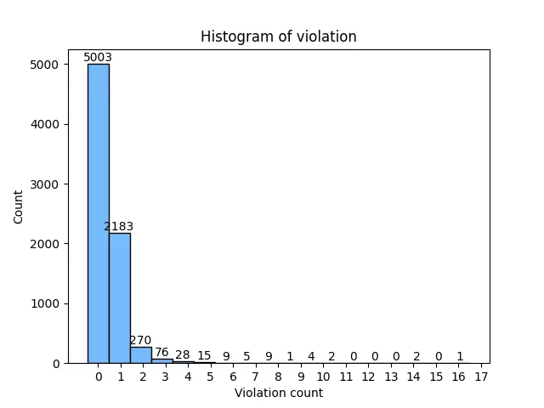
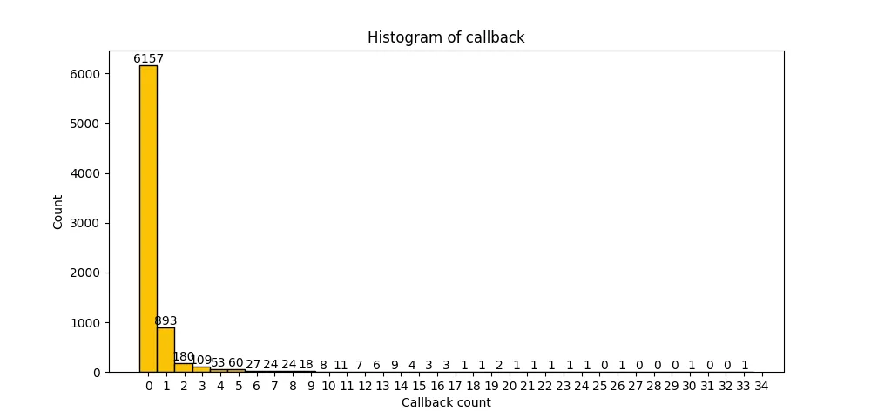
資料分布(違規與通知臨檢)
違規數直方圖
通知臨檢數直方圖
Label | Total count | Mean | STD | Min | Max | First quartile (Q1) | Medium (Q2) | Third quartile (Q3)
違規數 (violation) | 7608 | 0.449132 | 0.876366 | 0 | 17 | 0 | 0 | 1
通知臨檢數 (callback) |  | 0.487382 | 1.765643 | 0 | 34 | 0 | 0 | 0
Follow up
因違規數與通知臨檢數分布裝況相似，故先以違規數預測為目標建立模型，待建立適當模型之後再應用到通知臨檢數預測

Slide 7
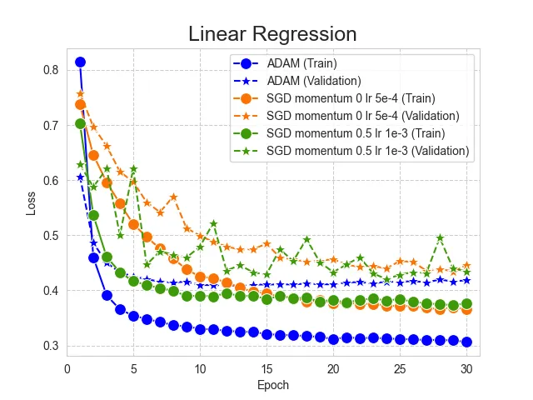
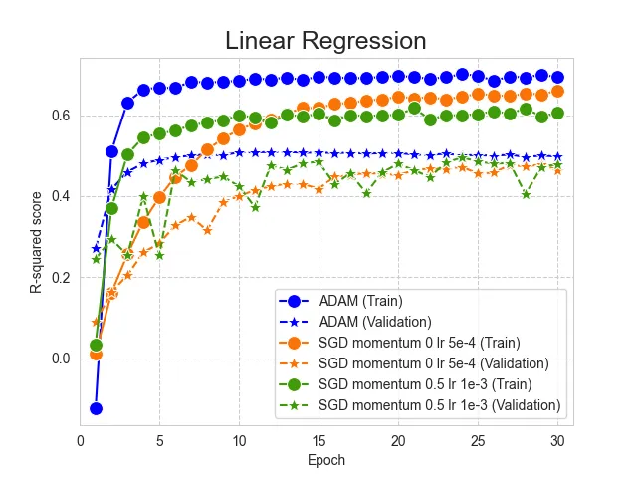
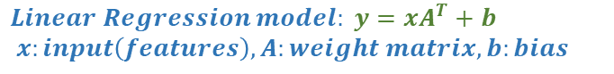
Linear Regression (basis of violation)
Loss
Model parameters:
Model: Linear regression
Loss function: MSE**
$$Linear Regression model: y=xA^{T}+b$$
$$x:input\left(features\right), A:weight matrix, b:bias$$
Optimizer | Optimizer parameters | Learning rate (lr) | Batch size | Epoch | Train |  | Validation
 |  |  |  |  | Loss* | R-squared score* | Loss* | R-squared score*
SGD*** | Momentum: 0 | 1e-3 | 60 | 30 | 0.4288843 | 0.5262989 | 0.4364961 | 0.4756923
 |  | 1e-3 | 60 | 60 | 0.4057645 | 0.5375563 | 0.5581278 | 0.3295916
 |  | 1e-3 | 300 | 30 | 0.4321562 | 0.4801074 | 0.4871363 | 0.4148647
 |  | 1e-3 | 30 | 30 | 0.5008004 | 0.3097066 | 0.4306597 | 0.4827029
 |  | 2e-3 | 60 | 30 | nan | nan | nan | nan
 |  | 5e-4 | 60 | 30 | 0.3660745 | 0.6597456 | 0.4458718 | 0.4644305
 | Momentum: 0.5 | 1e-3 | 60 | 30 | 0.3763752 | 0.6051593 | 0.4343925 | 0.4782192
 | Momentum: 0.9 | 1e-3 | 60 | 30 | 0.4757995 | 0.3737243 | 0.5658410 | 0.3203267
ADAM | β1: 0.9 Β2: 0.999 | 1e-3 | 60 | 30 | 0.3064100 | 0.6938973 | 0.4186387 | 0.4971422
R-squared score
Result
使用ADAM做優化方法，在訓練集與驗證集都能夠得到最佳的表現(最低的loss與最高的R-squared score)
最優的訓練與驗證情況下，有明顯的under-fitting現象(training表現好，但validation與training的loss有明顯差距)
Follow up
以ADAM作為優化方式做後續模型訓練
改進linear regression (Feature normalize, Feature selection, Change model)
*: Last epoch, 3-time average, **: MSE=Mean squared error, ***:Stochastic gradient descent

Slide 8
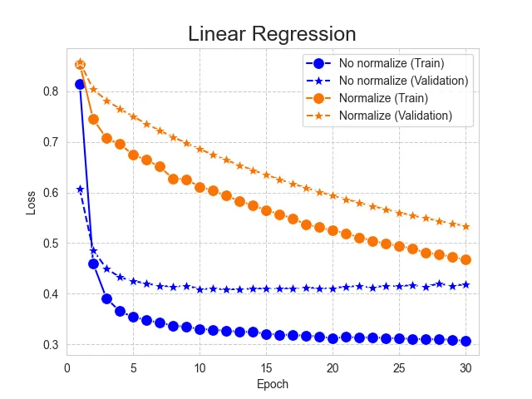
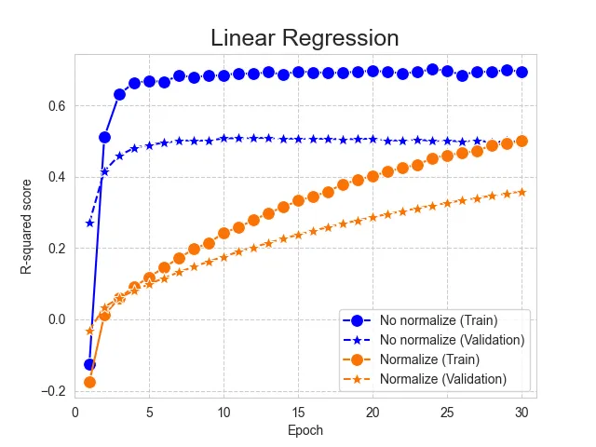
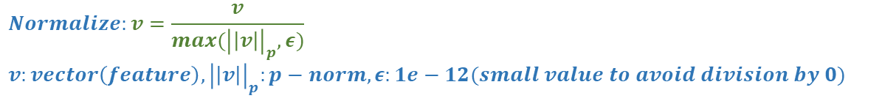
Linear Regression with normalization
Model parameters:
Model: Linear regression
Loss function: MSE**
Optimizer: ADAM
$$Normalize:v=\frac{v}{max({\left|\left|v\right|\right|}_{p},ε)}$$
$$v:vector\left(feature\right), {\left|\left|v\right|\right|}_{p}:p−norm, ε:1e−12(small value to avoid division by 0)$$
Model | Loss function | Optimizer | Learning rate (lr) | Batch size | Epoch | Feature normalize | Train |  | Validation |  | Remark
 |  |  |  |  |  |  | Loss* | R-squared score* | Loss* | R-squared score*
Linear Regression | MSE | ADAM | 1e-3 | 60 | 30 | X | 0.3064100 | 0.6938973 | 0.4186387 | 0.4971422 | basis
 |  |  |  |  |  | O | 0.4672726 | 0.5000631 | 0.5338425 | 0.3587625
Loss
R-squared score
Result
將輸入的資料集做正規化(normalize)之後再做模型訓練，反而降低模型預測表現 -> 正規化的過程可能扭曲了原本資料的特徵
Follow up
Feature selection:
F-statistic
Mutual information
Change model
*: Last epoch, 3-time average, **: MSE=Mean squared error

Slide 9
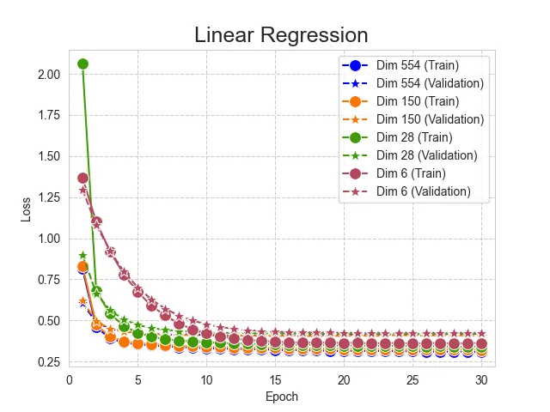
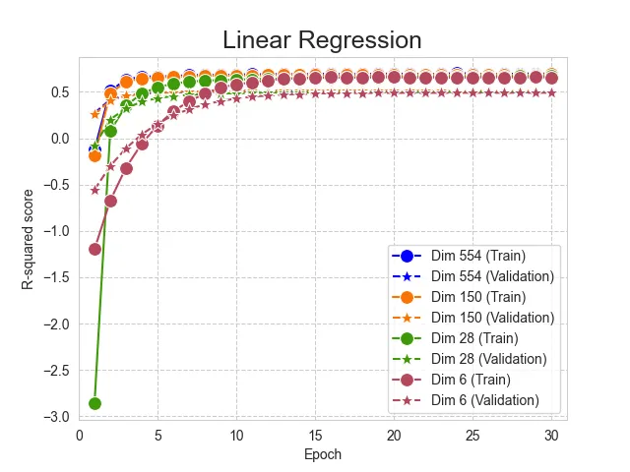
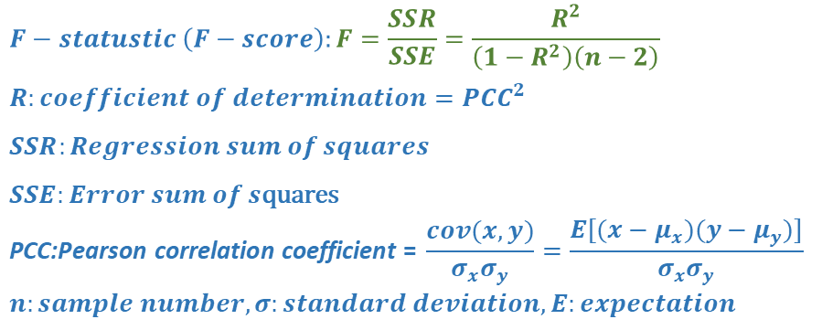
Feature selection (F-statistic)
Model parameters:
Model: Linear regression
Loss function: MSE
Optimizer: ADAM
$$F−statustic \left(F−score\right):F=\frac{SSR}{SSE}=\frac{R^{2}}{\left(1−R^{2}\right)\left(n−2\right)}$$
$$R:coefficient of determination={PCC}^{2}$$
$$SSR:Regression sum of squares$$
$$SSE:Error sum of s\text{quares}$$
$$\text{PCC}\text{:}\text{Pearson} \text{correlation} \text{coefficient} \text{= }\frac{cov(x,y)}{σ_{x}σ_{y}}=\frac{E[(x−μ_{x})(y−μ_{y})]}{σ_{x}σ_{y}}$$
$$n:sample number, σ:standard deviation, E:expectation$$
Learning rate: 1e-3
Batch size: 60
Epoch: 30
F-statistic** |  | Train |  | Validation |  | Remark
Value | Input dimension | Loss* | R-squared score* | Loss* | R-squared score*
>0 | 554 | 0.3064100 | 0.6938973 | 0.4186387 | 0.4971422 | basis
>10 | 150 | 0.3208554 | 0.6899765 | 0.4095975 | 0.5080022
>100 | 28 | 0.3419791 | 0.6693648 | 0.4191149 | 0.4965701
>1000 | 6 | 0.3611655 | 0.6543159 | 0.4247877 | 0.4897562
Result
針對輸入的資料集，以各項欄位與目標欄位的F-statistic為依據做特徵篩選，模型預測效果幾乎無提升
Follow up
Feature selection:
F-statistic
Mutual information
Change model
Loss
R-squared score
*: Last epoch, 3-time average, **: F-statistic of feature to target

Slide 10
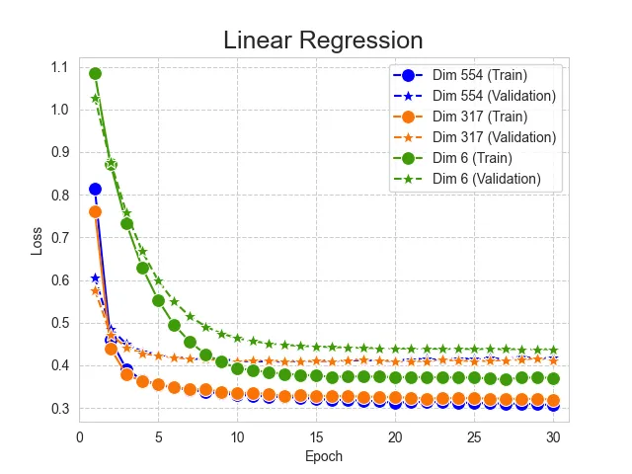
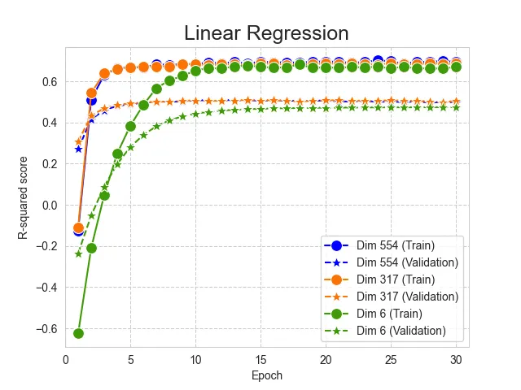
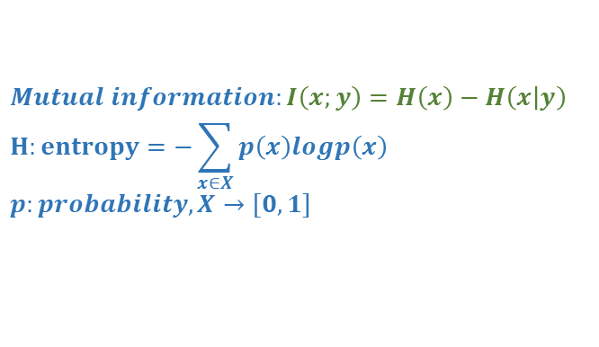
Feature selection (Mutual information)
Model parameters:
Model: Linear regression
Loss function: MSE
Optimizer: ADAM
Learning rate: 1e-3
Batch size: 60
Epoch: 30
$$Mutual information:I\left(x;y\right)=H\left(x\right)−H\left(x | y\right)$$
$$H:entropy=−\sum_{x∈X}{p\left(x\right)logp\left(x\right)}$$
$$p:probability, X→[0,1]$$
Mutual information** |  | Train |  | Validation |  | Remark
Value | Input dimension | Loss* | R-squared score* | Loss* | R-squared score*
>=0 | 554 | 0.3064100 | 0.6938973 | 0.4186387 | 0.4971422 | basis
>0 | 317 | 0.3197875 | 0.6860469 | 0.4123875 | 0.5046510
>0.1 | 6 | 0.3709708 | 0.6699255 | 0.4379335 | 0.4739658
Result
針對輸入的資料集，以各項欄位與目標欄位的mutual information為依據做特徵篩選，仍無法更進一步提高模型預測表現
Follow up
Feature selection:
F-statistic
Mutual information
Change model
Loss
R-squared score
*: Last epoch, 3-time average
**: Mutual information of feature to target

Slide 11
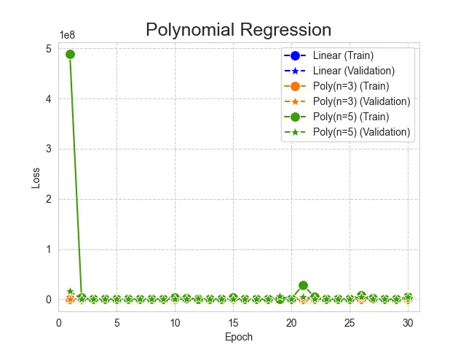
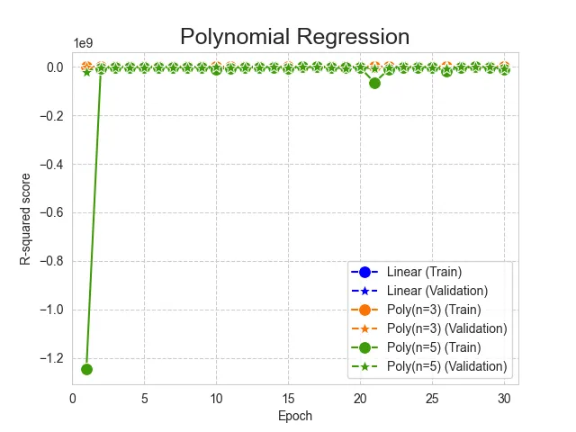
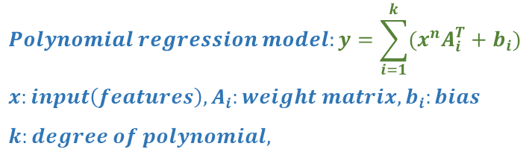
Polynomial Regression
Model parameters:
Loss function: MSE
Optimizer: ADAM
Learning rate: 1e-3
Batch size: 60
Epoch: 30
$$Polynomial regression model:y=\sum_{i=1}^{k}{(x^{n}A_{i}^{T}+b_{i})}$$
$$x:input\left(features\right), A_{i}:weight matrix, b_{i}:bias$$
$$k:degree of polynomial,$$
Model | Order | Train |  | Validation |  | Remark
 |  | Loss* | R-squared score* | Loss* | R-squared score*
Linear Regression | 1 | 0.3064100 | 0.6938973 | 0.4186387 | 0.4971422 | basis
Polynomial Regression | 3 | 2.1694204 | -3.2830548 | 0.8447978 | -0.0147490
 | 5 | 4589868 | -10609135 | 4599860 | -5525230
Result
改以polynomial regression模型做訓練，次方項使用3與5，結果隨次方項越高，模型表現越糟
Follow up
Polynomial regression不適合此數據集 -> 更換模型(增加非線性項)
Loss
R-squared score
*: Last epoch, 3-time average

Slide 12
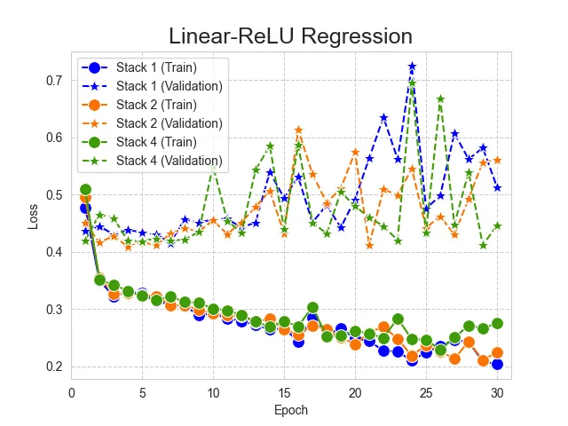
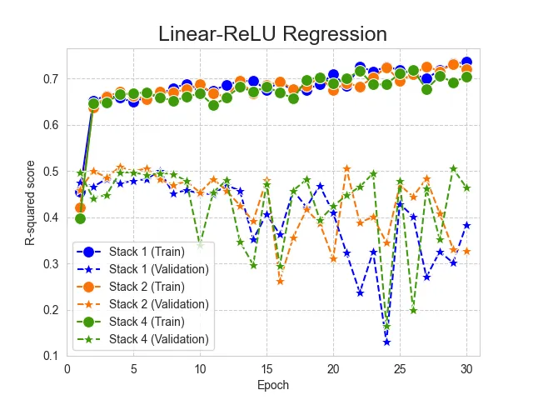
Linear-ReLU-Stack model
Loss
Model parameters:
Loss function: MSE
Optimizer: ADAM
Learning rate: 1e-3
input
Batch size: 60
Epoch: 30
linear
Model | Hidden layer dimension (k) | Stack | Train |  | Validation |  | Remark
 |  |  | Loss* | R-squared score* | Loss* | R-squared score*
Linear Regression | -- | -- | 0.3064100 | 0.6938973 | 0.4186387 | 0.4971422 | basis
Linear-ReLU-Stack | 150 | 1 | 0.2038442 | 0.7357851 | 0.5131123 | 0.3836630 | Best
 |  | 2 | 0.2246312 | 0.7208224 | 0.5606091 | 0.3266111
 |  | 4 | 0.2757942 | 0.7040693 | 0.4461970 | 0.4640398
 | 300 | 1 | 0.2464263 | 0.7060142 | 0.4967789 | 0.4032822
 |  | 2 | 0.2160820 | 0.7291330 | 0.5949330 | 0.2853821
 |  | 4 | 0.3375792 | 0.6595090 | 0.4545721 | 0.4539799
 | 450 | 1 | 0.2470764 | 0.6948695 | 0.4377767 | 0.4741541
 |  | 2 | 0.2231620 | 0.7262291 | 0.4747582 | 0.4297329
 |  | 4 | 0.3012085 | 0.6501858 | 0.4843106 | 0.4182589
Hidden layer
(dimension k, stack n)
linear
R-squared score
ReLU
linear
output
Follow up
導入不同的activation function做模型訓練(以stack=1、不同hidden layer dimension做測試)
Result
以Linear-ReLU-Stack方式做模型訓練，調整hidden layer的dimension與堆疊數，的確能讓訓練集的loss降低與R-squared score提高(以hidden layer dimension 150, stack 1表現最好)，但在驗證集的表現卻都更糟 -> over-fitting
*: Last epoch, 3-time average

Slide 13
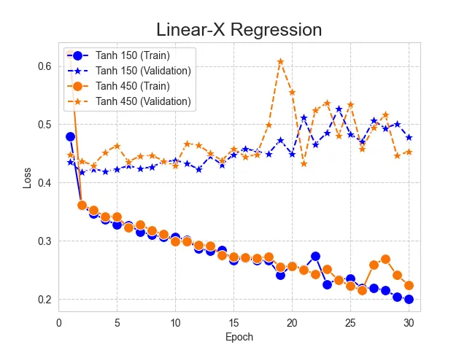
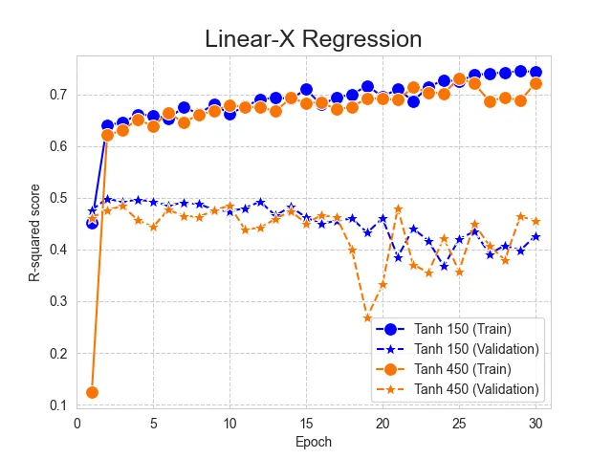
Linear-X-Stack (1 stack)
Loss
Model parameters:
Loss function: MSE
Optimizer: ADAM
Learning rate: 1e-3
Batch size: 60
Epoch: 30
input
Model | Activation function (X) | Hidden layer dimension (k) | Train |  | Validation |  | Remark
 |  |  | Loss* | R-squared score* | Loss* | R-squared score*
Linear Regression | -- | -- | 0.3064100 | 0.6938973 | 0.4186387 | 0.4971422 | basis
Linear-X-Stack | ReLU | 150 | 0.2038442 | 0.7357851 | 0.5131123 | 0.3836630
 |  | 450 | 0.2470764 | 0.6948695 | 0.4377767 | 0.4741541
 | Leaky ReLU (negative slope=0.01) | 150 | 0.2201182 | 0.7123433 | 0.6219396 | 0.2529425
 |  | 450 | 0.2663891 | 0.6933903 | 0.5170890 | 0.3788863
 | Tanh | 150 | 0.1995130 | 0.7435284 | 0.4774836 | 0.4264593 | Best
 |  | 450 | 0.2244203 | 0.7217234 | 0.4529604 | 0.4559159
linear
Hidden layer
(dimension k, stack 1)
linear
R-squared score
X
linear
Result
使用不同的activation function都使得模型有over-fitting的現象 -> 模型over-fitting主因非activation function
每一個neuron都是先透過linear作為處理input的方式 -> 或許此資料集非線性可分，導致此模型over-fitting
Follow up
使用non-linear-based model來做為模型
output
*: Last epoch, 3-time average

Slide 14
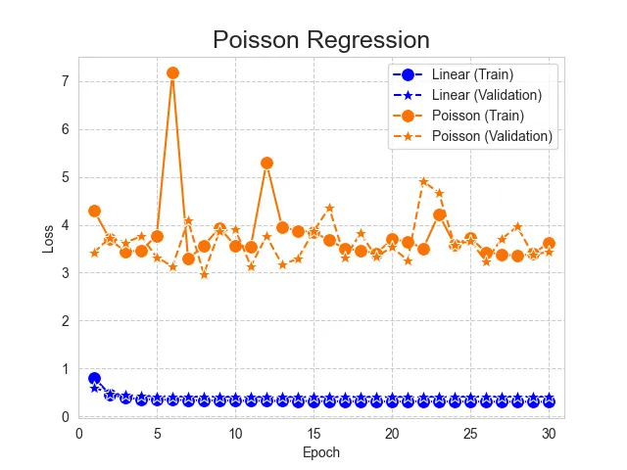
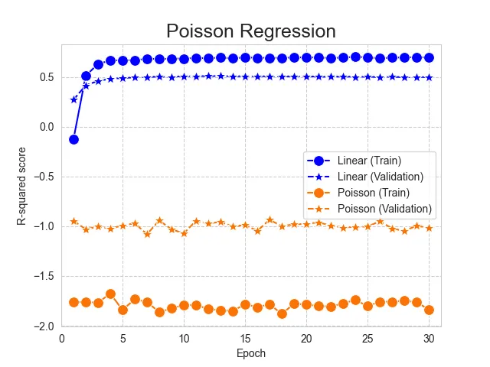
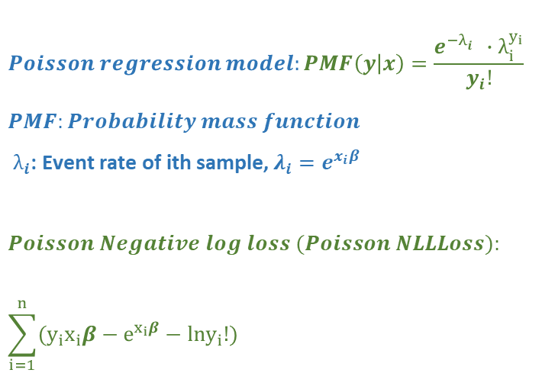
Poisson Regression
$$Poisson regression model:PMF\left(y | x\right)=\frac{e^{−λ_{i}^{}}{∙λ}_{i}^{y_{i}}}{y_{i}!}$$
$$PMF:Probability mass function$$
$${ λ}_{i}\text{:} \text{Event} \text{rate} \text{of} \text{ith} \text{sample}\text{,} λ_{i}=e^{x_{i}β}$$
$$Poisson Negative log loss (Poisson NLLLoss):$$
$$\sum_{i=1}^{n}{(y_{i}x_{i}β−e^{x_{i}β}−lny_{i}!})$$
Model parameters:
Optimizer: ADAM
Learning rate: 1e-3
Batch size: 60
Epoch: 30
Loss function | Optimizer | Model | Train |  | Validation |  | Remark
 |  |  | Loss* | R-squared score* | Loss* | R-squared score*
MSE | ADAM | Linear Regression | 0.3064100 | 0.6938973 | 0.4186387 | 0.4971422 | basis
 |  | Poisson Regression | 3.6194012 | -1.8375176 | 3.4364971 | -1.0151096
Poisson NLLLoss
Result
Poisson regression常用於計數型態(count-based)的資料回歸分析。迴歸分析結果發現預測效果極差，且模型無法優化 -> Poisson distribution的假設之下mean = variance，與實際狀況不符
Follow up
使用其他不同count-based model做模型
Negative binomial regression
Generalized Poisson regression
Zero inflated Poission regression
Loss
R-squared score
*: Last epoch, 3-time average

Slide 15
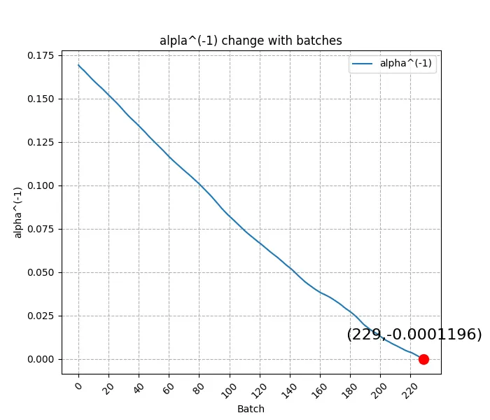
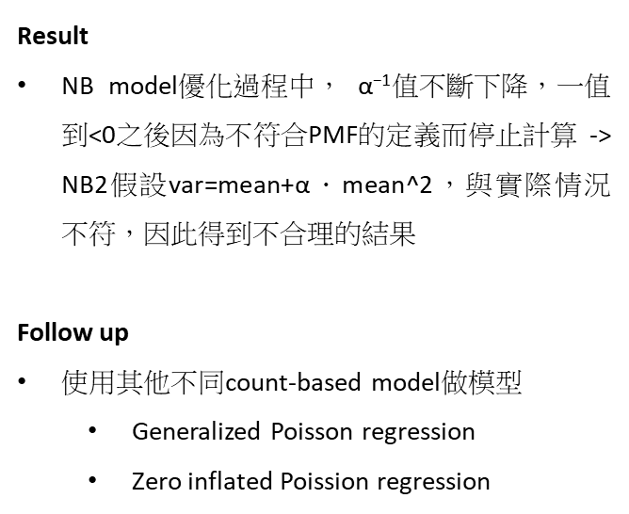
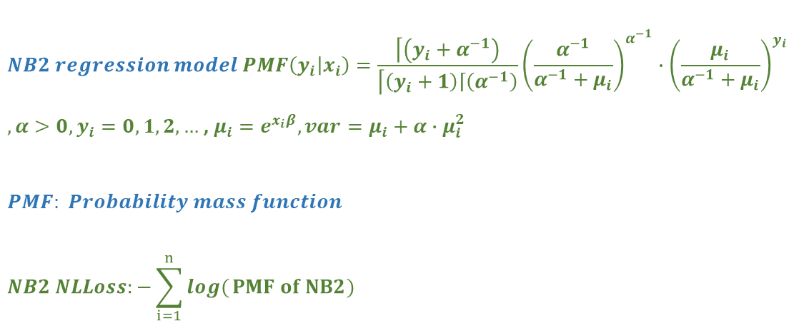
Negative Binomial 2 (NB2) Regression
Model parameters:
Optimizer: ADAM
Learning rate: 1e-3
Batch size: 60
Epoch: 30
Loss function | Optimizer | Model | Train |  | Validation |  | Remark
 |  |  | Loss* | R-squared score* | Loss* | R-squared score*
MSE | ADAM | Linear Regression | 0.3064100 | 0.6938973 | 0.4186387 | 0.4971422 | basis
 |  | NB Regression (p=2) | -- | -- | -- | --
NB2 NLLLoss
Result
NB model優化過程中， $\text{α}\text{−1}$值不斷下降，一值到<0之後因為不符合PMF的定義而停止計算 -> NB2假設var=mean+α．mean^2，與實際情況不符，因此得到不合理的結果
Follow up
使用其他不同count-based model做模型
Generalized Poisson regression
Zero inflated Poission regression
$$NB2 regression model PMF\left(y_{i} | x_{i}\right)=\frac{\left\lceil \left(y_{i}+α^{−1}\right)\right.}{\left\lceil \left(y_{i}+1\right)\left\lceil \left(α^{−1}\right)\right.\right.}{\left(\frac{α^{−1}}{α^{−1}+μ_{i}}\right)}^{α^{−1}}∙{\left(\frac{μ_{i}}{α^{−1}+μ_{i}}\right)}^{y_{i}}$$
$, α>0, y_{i}=0, 1, 2, …$, $μ_{i}=e^{x_{i}β}, var=μ_{i}+α∙μ_{i}^{2}$
$$PMF: Probability mass function$$
$$NB2 NLLoss:−\sum_{i=1}^{n}{log(}PMF of NB2)$$

Slide 16
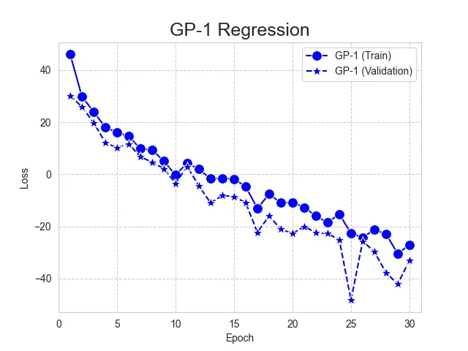
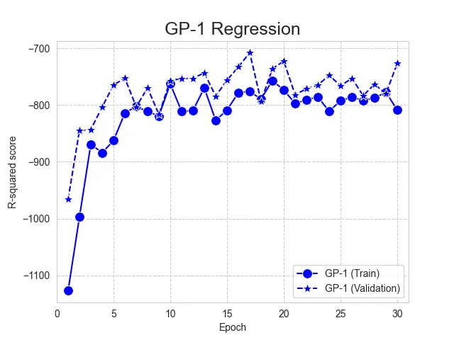
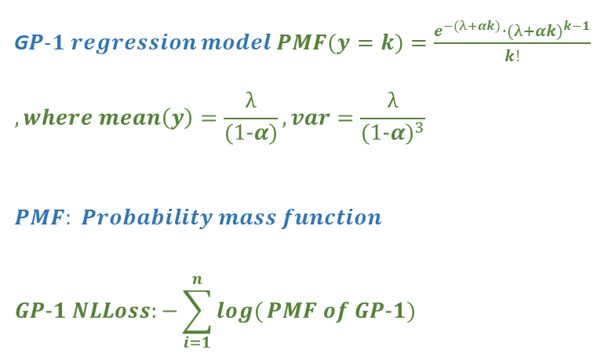
Generalized Poisson Regression
G$P-1 regression model PMF(y=k)=\frac{e^{−(λ+αk)}∙{(λ+αk)}^{k−1}}{k!}$
$$, where mean\left(y\right)=\frac{λ}{(1-α)}, var=\frac{λ}{{(1-α)}^{3}}$$
$$PMF: Probability mass function$$
$$GP-1 NLLoss:−\sum_{i=1}^{n}{log(}PMF of GP-1)$$
Model parameters:
Optimizer: ADAM
Learning rate: 1e-3
Batch size: 60
Epoch: 30
Loss function | Optimizer | Model | Train |  | Validation |  | Remark
 |  |  | Loss* | R-squared score* | Loss* | R-squared score*
MSE | ADAM | Linear Regression | 0.3064100 | 0.6938973 | 0.4186387 | 0.4971422 | basis
 |  | Generalized Poisson-1 | -27.06355 | -808.7693 | -33.04931 | -726.5347
GP-1 NLLLoss
Loss
R-squared score
Result
利用GP-1 model來做regression，得到極糟的結果 -> 無法找到適當的α值來符合此模型中對於mean與variance的假設
Follow up
使用其他不同count-based model做模型
Zero inflated Poission regression

Slide 17
未來研究方向
Zero Inflated Poisson Regression to violation occurrence count prediction
Regression model for violation / callback occurrence count prediction
Apply to schedule arrangement for better performance

Slide 18
Appendix

Slide 19
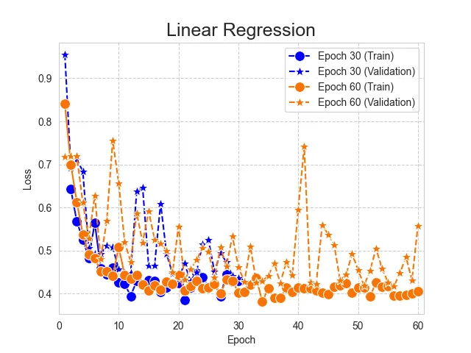
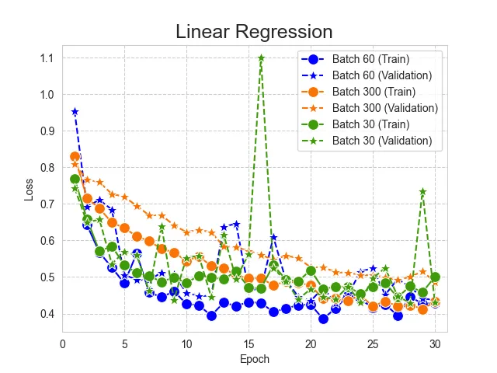
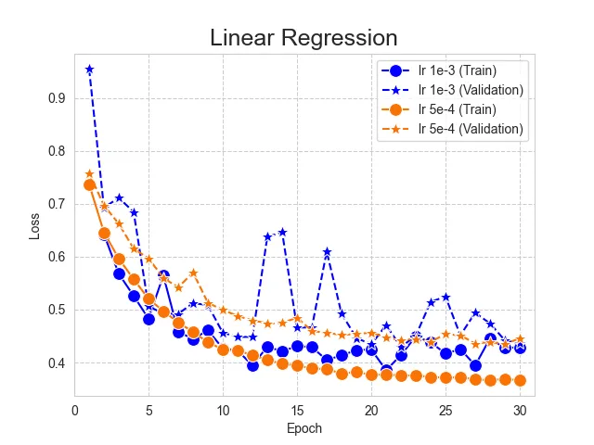
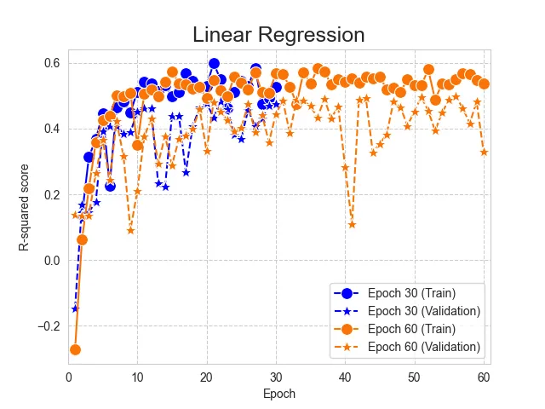
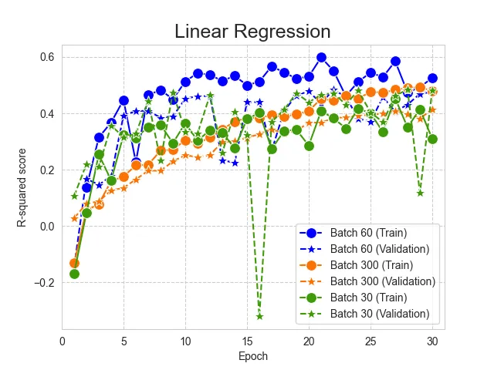
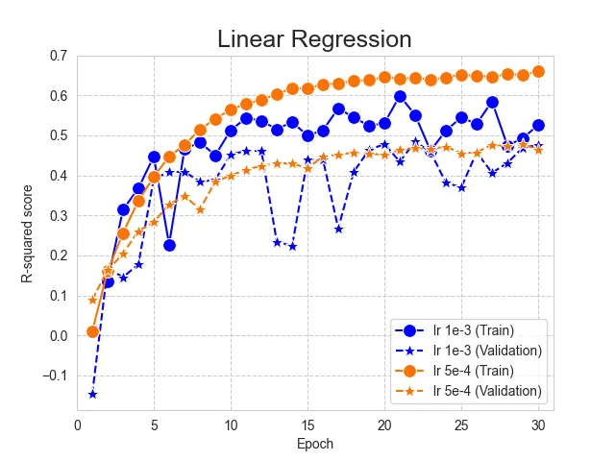
Linear Regression (SGD optimization)

Slide 20
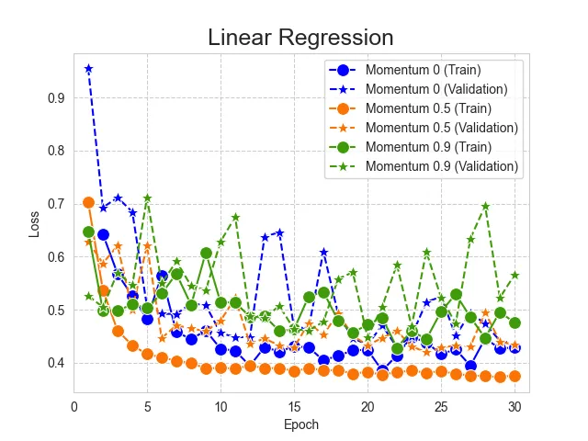
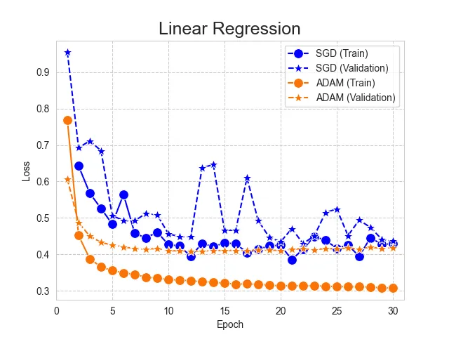
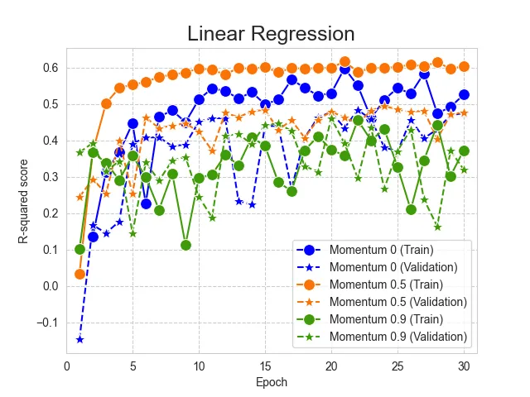
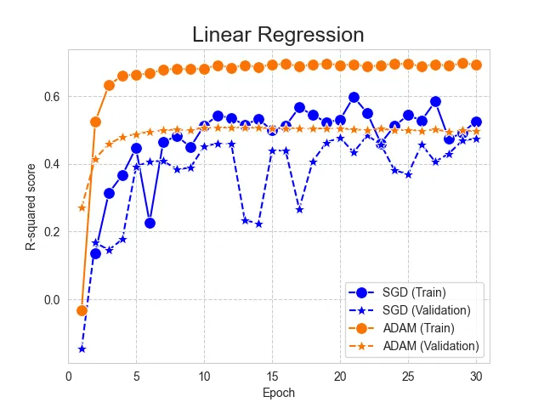
Linear Regression (SGD optimization and ADAM)

Slide 21
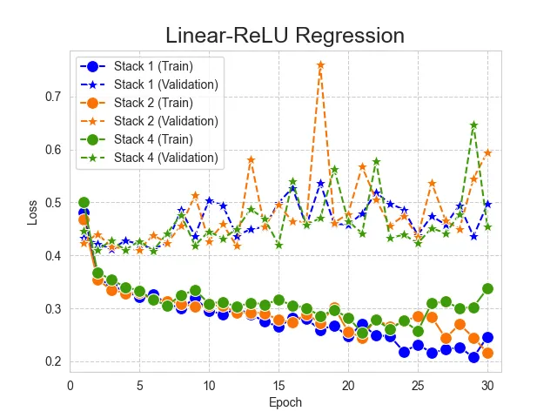
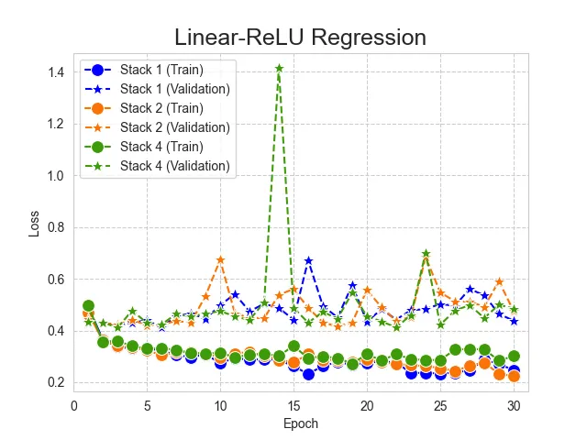
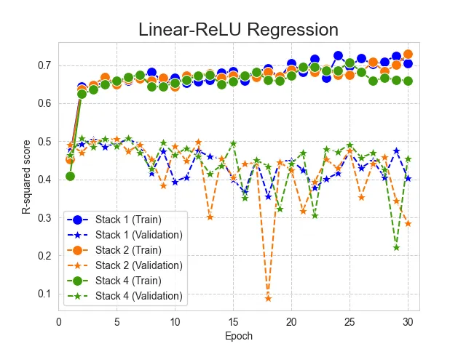
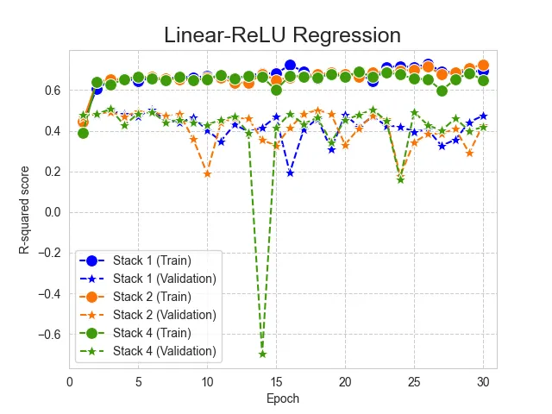
Linear-ReLU-Stack model

Slide 22
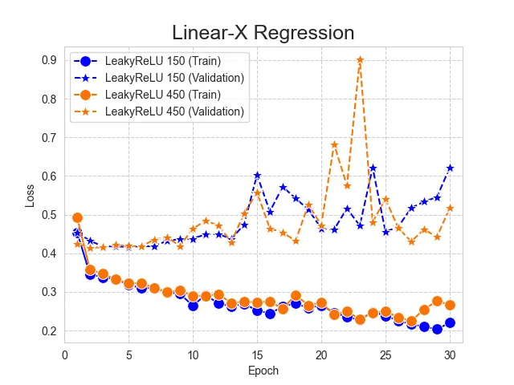
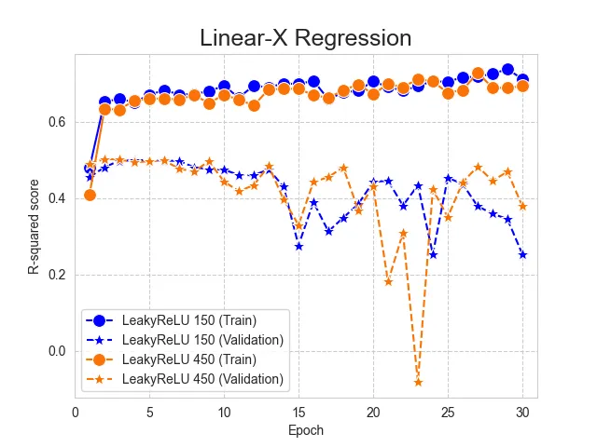
Linear-X-Stack

Slide 23
Zero-Inflated Poisson Regression

Slide 24
Linear replacement _ input layer
Loss function | Optimizer | Model | Input layer | Input layer parameters | Hidden layer (stack 1) | Output layer | Train |  | Validation
 |  |  |  |  |  |  | Loss* | R-squared score* | Loss* | R-squared score*
MSE | ADAM | Linear Regression | -- |  | -- |  | 0.3064100 | 0.6938973 | 0.4186387 | 0.4971422
 |  | Linear-ReLU-Stack | Linear | -- | Linear-ReLU (Dim 450 for Linear input) | Linear
 |  |  | Convolution (1D) | k size: 50
 |  |  |  | k size: 150
 |  |  |  | k size: 250

Slide 25
Linear Regression
盒狀圖(loss, R-squared, Adjusted R-squared)
折線圖(loss, R-squared, Adjusted R-squared)
3次平均折線圖_同一個epoch(loss, R-squared, Adjusted R-squared)
3次平均折線圖_epoch30與60(loss, R-squared, Adjusted R-squared)

